Slide 1
Project Organization Management
Chapter 3 and 14

Slide 2
Lecture Outline
Project Definition
Project Organization
Roles
Tasks & Activities
Work Product & Deliverables

Slide 3
How it should go
Requirements
Analysis
Design
Implementation
System Testing
Delivery and Installation

Slide 4

How it often goes
Requirements
Analysis
Bananaware
ripes with the
Customer
D
E
L
A
Y
Vaporware

Slide 5
Laws of Project Management
Projects progress quickly until they are 90% complete
  Then they remain at 90% complete forever
If project content is allowed to change freely, the rate of change will exceed the rate of progress
Project teams detest progress reporting because it manifests their lack of progress
Murphy’s law:
  “When things are going well, something will go wrong”
  “When things just can’t get worse, they will”
  “When things appear to be going better, you have overlooked something.”
Notes:
The 90% syndrom is a problem that is particularly symptomatic for the linear waterfall lifecycle
Another variant of Murphy's law
Free change problem must be dealt with even in an iterative and incremental software lifecycle: time-boxed prototyping
Introducing new bugs: This is a significant problem in old systems that did not use encapsulation: Global variables, etc
Problem with hierarchical project management

Slide 6
Project Definition
A project is an undertaking, limited in time, to achieve a set of goals that require a concerted effort
A project includes
  A set of deliverables to a client
  A schedule
  Technical and managerial activities required to produce and deliver the deliverables
  Resources consumed by the activities (people, budget)
Focus of project management
  Administer the resources
  Maintain accountability
  React to change
  Make sure, the goals are met.

Slide 7
Simple Object Model of a Project
Project
Deliverables
Schedule
Activity
Resource

Slide 8
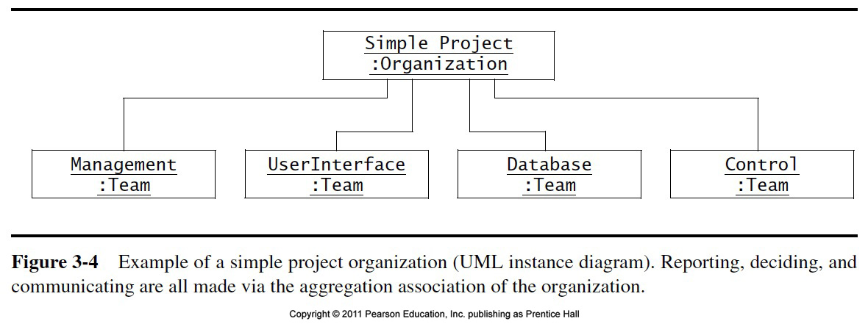
Simple Object Model of a Project

Slide 9
Dynamic Model of a Project
Scope Defined
Definition
Start
do/Define Scope
do/Assign Tasks
Tasks
Assigned
Termination
Steady State
do/Deliver System
do/Develop System
System Done
Notes:
A project here is modeled as an object with interesting dynamic behavior, namely a set of different states that are very important for a project manager.

Slide 10
Project Organization
A project organization defines the relationships among resources, in particular the participants, in a project
A project organization should define
  Who decides (decision structure)
  Who reports their status to whom (reporting structure)
  Who communicates with whom (communication structure)
Organization
*
Team
*
Participant

Slide 11
Example of a Communication Structure
Management
:Team
communicateDecision()
communicateDecision()
communicateStatus()
communicateStatus()
UserInterface
Control
:Team
Database
:Team
:Team

Slide 12
Reporting vs. Communication
Reporting supports project management in tracking project status
  What work has been completed?
  What work is behind schedule?
  What issues threaten project progress?
Reporting along the hierarchy is not sufficient when two teams need to communicate
  A communication structure is needed
  A participant from each team is responsible for facilitating communication between both teams
  Such participants are called liaison

Slide 13
Example of a Communication Structure
Interface with
other team
Role
UserInterface
:Team
Alice
communicates
Management:
Team leader
:Developer
Team
John
communicates
Architecture:
API engineer
:Developer
Team
Mary
communicates
Documentation:
Editor
:Developer
Team
Chris
communicates
Testing:
Implementor
:Developer
Team
Sam
Implementor
:Developer

Slide 14
Hierarchical Project Organization
Chief Executive
First Level Manager
(“Front-Line Manager”)
Project Members
A
B
A wants to talk to B: Information Flow
A wants to make sure B does a certain change: Controlflow
Basis of organization:
Complicated information and control flow
across hierarchical boundaries

Slide 15
Peer-To-Peer Communication
Project
Leader
Coaches
Subsystem Team
Subsystem Team
Subsystem Team
A
B
Team
Members
A wants to talk to B: Simple Information Flow
A wants to make sure B does a certain change: Simple Controlflow
Basis of organization:
Nonlinear information flow across dynamically formed units
Notes:
Project-based organizations create bridges within organizations and bridge boundaries outside with customers, suppliers, and competitors. Teams are the foundation unit of these new patterns of interconnection and interdependence. Telecommunications technology is the nervous system that holds these networks together. Groupware is the collaboration support technology that shapes and holds the activity of teams within those networks."
Project-based organizations are based on the fct that ever-shifting networks of teams that cross traditional, formerly forbidden boundaries, linking once-competing organizations into ecosystems of cooperation

Slide 16
Role
A role defines a set responsibilities (“to-dos”)
Examples
Role: Tester
  Write tests
  Report failures
  Check if bug fixes address a specific failure
Role: System architect
  Ensure consistency in design decisions and define subsystem interfaces
  Formulate system integration strategy
Role: Liaison
  Facilitate communication between two teams.

Slide 17
Types of Roles in Software Organizations
Developer
API Engineer
Document Editor
Liaison
Configuration Manager
Role
Tester
Project Manager
Manager
Team Leader
Application Domain Expert
Consultant
Solution Domain Expert
Client
End User

Slide 18
Responsibilities are assigned to Roles,
Roles are assigned to People
Team A .
“To Do” List for the Project
Role 1
Item 1
Person A
• Item 1
• Item 2
Item 2
Item 9
Role 1
• Item 3
• Item 4
Role 2
Role 2
Item 4
• Item 5
Item 5
• Item 6
Item 7
• Item 7
Person B
• Item 8
Role 3
• Item 9
Item 3
Role 3
Item 6
Item 8

Slide 19
Possible Mappings of Roles to Participants
One-to-One
  Ideal but rare
Many-to-Few
  Each project member assumes several "hats"
  Danger of over-commitment
  Need for load balancing
Many-to-"Too-Many"
  Some people don't have significant roles
  Lack of accountability
  Loosing touch with project

Slide 20
Task
A task describes the smallest amount of work tracked by management
Typically 3-10 working days effort
Tasks descriptions
  Role
  Work product
  Start date
  Planned duration
  Required resources.

Slide 21
Example: Tasks for building a House
Install Interior Plumbing
Install Interior Electrical
Install Wallboard
Paint
Interior
Install
Flooring
Install Interior Doors
Buy
Material
Build
Outside
Wall
Lay Foundation
Survey
Excavate
Build Outside Wall
Survey
Excavate
Buy
Material
Lay Foundation
FINISH
Install
Roofing
Request
Permits
Install Exterior Doors
Request
Permits
Paint
Exterior
Install Exterior Plumbing
Install Exterior Electrical
Install Exterior Siding

Slide 22
Example: Tasks for building a house
Install Interior Plumbing
Install Interior Electrical
Install Wallboard
Paint
Interior
Install
Flooring
Install Interior Doors
Buy
Material
Lay Foundation
Build Outside Wall
START
FINISH
Survey
Excavate
Install
Roofing
FINISH
Install Exterior Doors
Request
Permits
Paint
Exterior
Install Exterior Plumbing
Install Exterior Electrical
Install Exterior Siding

Slide 23
Tasks and Work Packages
A task is specified by a work package
  Description of work to be done
  Preconditions for starting, duration, required resources
  Work products to be produced, acceptance criteria for it
  Risks involved
A task must have completion criteria
  Includes the acceptance criteria for the work products (deliverables) produced by the task.

Slide 24
Work Products
A work product is a visible outcome of a task
Examples
  A document
  A review of a document
  A presentation
  A piece of code
  A test report
Work products delivered to the customer are called deliverables

Slide 25
Activities
Major unit of work
Culminates in a major project milestone:
  Scheduled event used to measure progress
  Internal checkpoints should not be externally visible
  A project milestone usually produces a baseline
Activities are often grouped again into higher-level activities with different names:
    Phase 1, Phase 2 …
    Step 1, Step 2 …
Allows separation of concerns
Precedence relations can exist among activities
  Example: “A1 must be executed before A2”
Notes:
Definition Baseline:
A formally reviewed work product which is placed under change control
Any change to a baseline requires the execution of a formally agreed upon procedure
Activitites are often grouped again into higher-level activities:
This Establishes hierarchical structure for project
Phases
Step...
PERT Charts are use to visualize precedence relations

Slide 26
Example: Activities for Building a House
Install Interior Plumbing
Install Interior Electrical
Install Wallboard
Paint
Interior
Install
Flooring
Install Interior Doors
Buy
Material
Lay Foundation
Build Outside Wall
START
Survey
Excavate
Install
Roofing
FINISH
Install Exterior Doors
Request
Permits
Paint
Exterior
Install Exterior Plumbing
Install Exterior Electrical
Install Exterior Siding

Slide 27
Example: Activities for Building a House
Install Interior Plumbing
Install Interior Electrical
Install Wallboard
Finish
Interior
Paint
Interior
Install
Flooring
Install Interior Doors
Establish
Foundation
Build
Outside Wall
Buy
Material
Lay Foundation
Build Outside Wall
FINISH
START
FINISH
START
Survey
Excavate
Install
Roofing
Install Exterior Doors
Request
Permits
Paint
Exterior
Finish
Exterior
Install Exterior Plumbing
Install Exterior Electrical
Install Exterior Siding

Slide 28
Examples of Software Engineering Activities
Planning
Requirements Elicitation
Analysis
System Design
Object Design
Implementation
Testing
Delivery

Slide 29
Project Management
Managers do not generate a useful product on their own
Managers provide and coordinate resources so that others can generate useful products.
Managing a software project requires a combination of managerial and social skills
Project management ensures the delivery of a quality system on time and within budget
three aspects of a project;
  Quality
  Budget
  Time

Slide 30
Project Management (Cont..)
A project consists of the following components:
  Outcome
  Work
  Schedule
  Resources
Project managers deal with project complexity and change

Slide 31
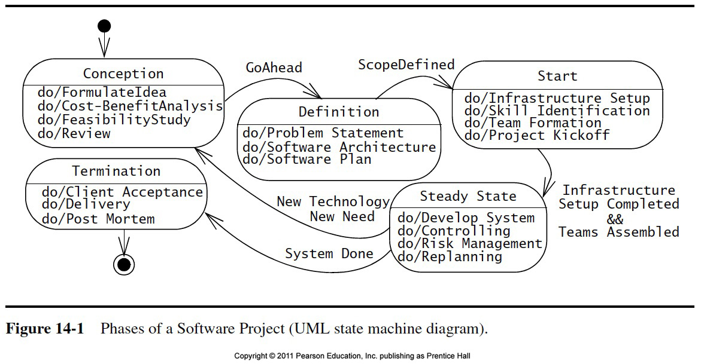
Project Phases

Slide 32
